Slide 1
Greedy is Great
Introduction to Greedy Strategy
Dustin Xu

Slide 2
Line Up for Western Food
A Warmup Task for You

Slide 3
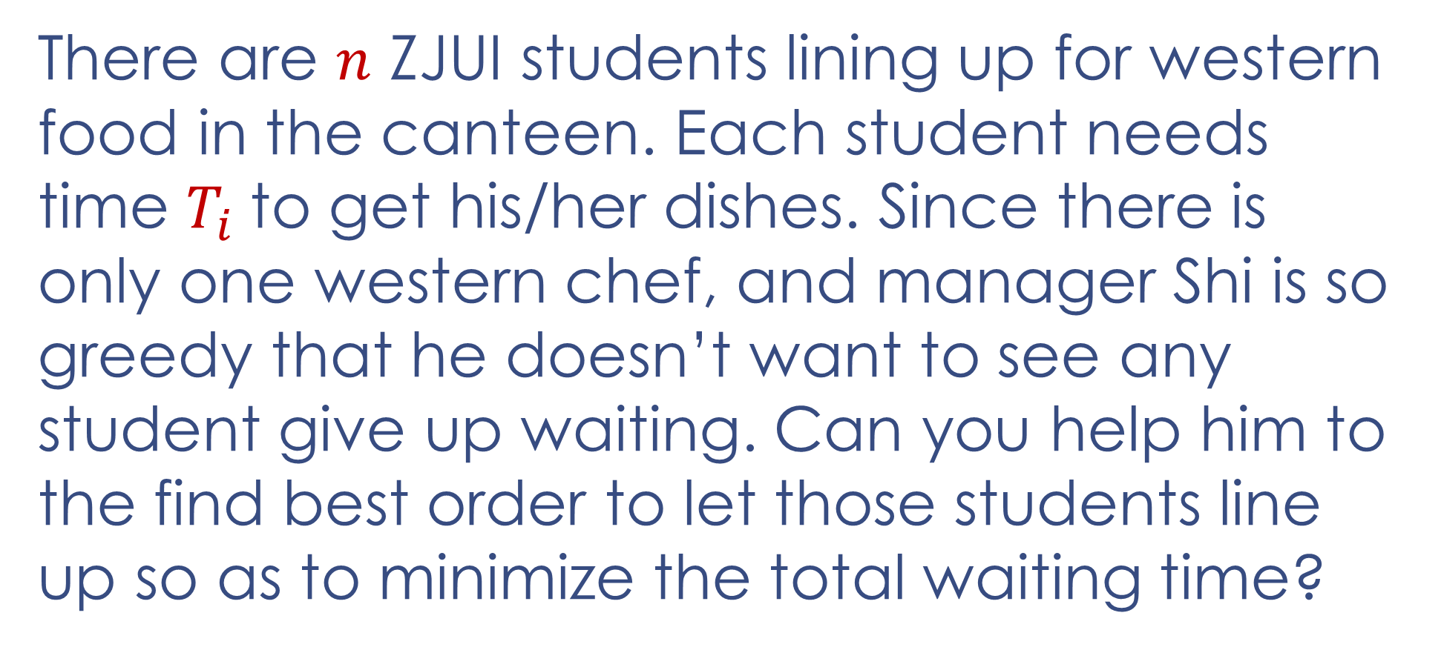
Line Up for Western Food
There are $n$ ZJUI students lining up for western food in the canteen. Each student needs time $T_{i}$to get his/her dishes. Since there is only one western chef, and manager Shi is so greedy that he doesn’t want to see any student give up waiting. Can you help him to the find best order to let those students line up so as to minimize the total waiting time?

Slide 4
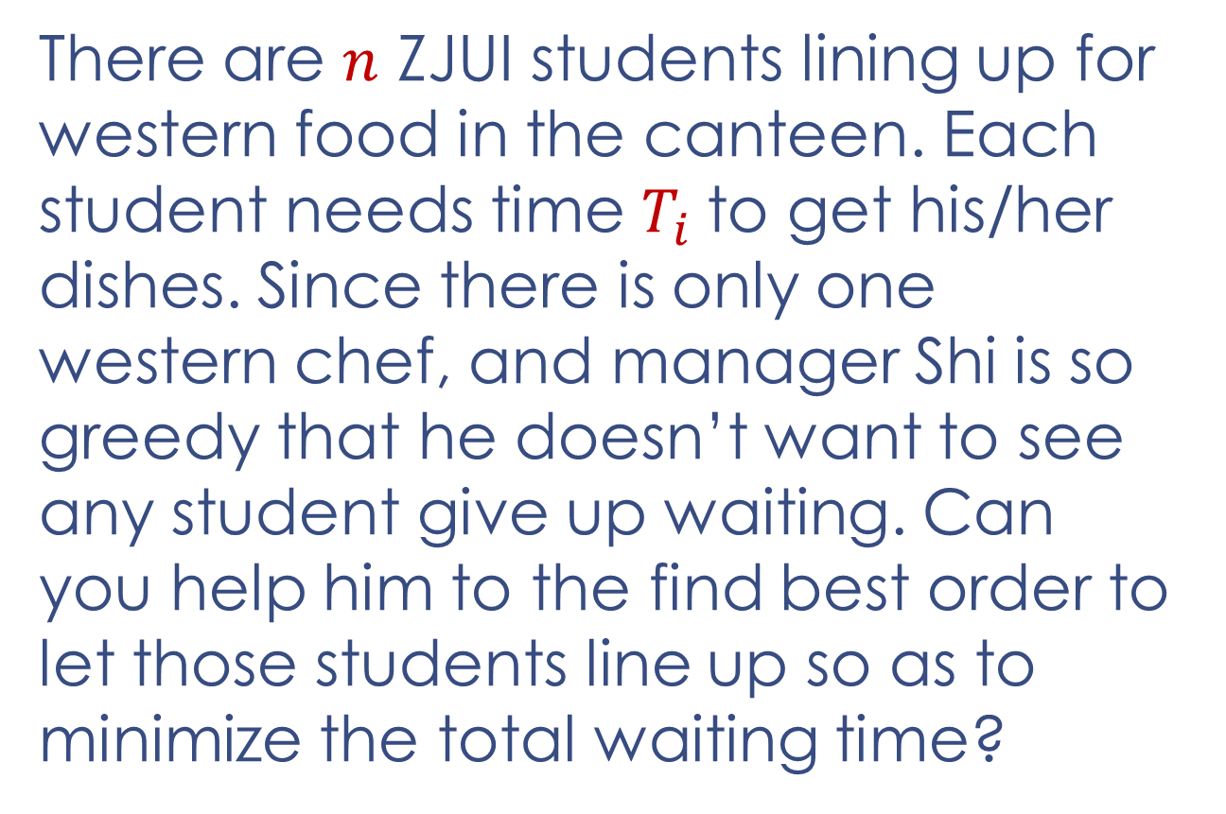
Line Up for Western Food
There are $n$ ZJUI students lining up for western food in the canteen. Each student needs time $T_{i}$to get his/her dishes. Since there is only one western chef, and manager Shi is so greedy that he doesn’t want to see any student give up waiting. Can you help him to the find best order to let those students line up so as to minimize the total waiting time?
e.g.
Five students:
Polar ♡ pasta 3 min
Vicky ♡ steak 5 min
Peter ♡ mutton chop 7 min
Zachary ♡ hamburger 2 min
Louise ♡ chicken chop 6 min
Polar 3
Vicky 3+5=8
Peter 3+5+7=15
Zachary 3+5+7+2=17
Louise 3+5+7+2+6=23
Total: 3+8+15+17+23=66

Slide 5
Segment Overlap
A Warmup Task for You

Slide 6
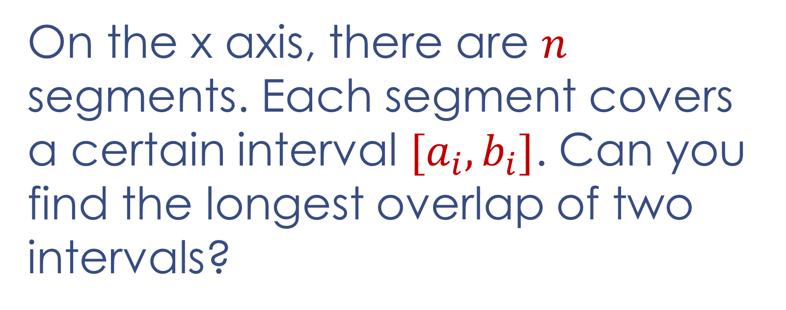
Segment Overlap
On the x axis, there are $n$ segments. Each segment covers a certain interval $[a_{i}, b_{i}]$. Can you find the longest overlap of two intervals?

Slide 7
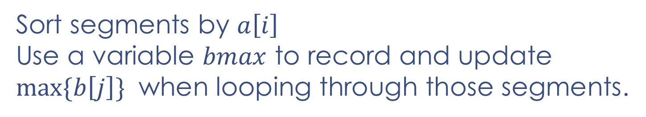
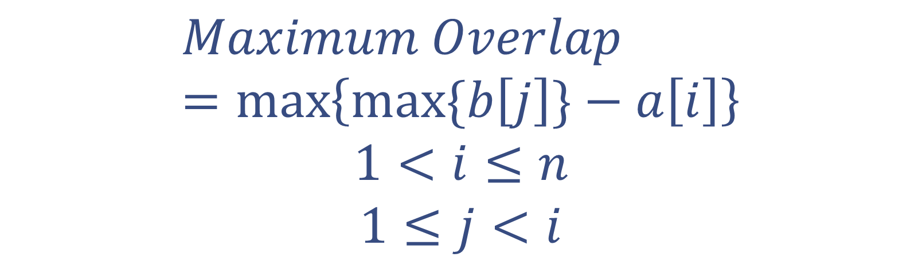
Segment Overlap
$$Maximum Overlap=\max\left\{max⁡\{b\left[j\right]\}−a\left[i\right]\right\}$$
$$1<i≤n$$
$$1≤j<i$$
Sort segments by $a\left[i\right]$
Use a variable $bmax$ to record and update $max⁡\{b\left[j\right]\}$ when looping through those segments.

Slide 8
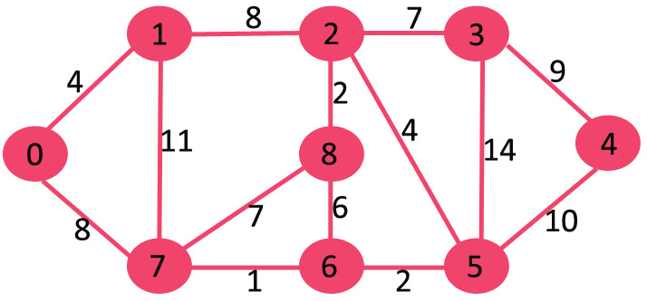
Greedy Strategy
Core idea: Make the locally optimal choice for every step and find the global optimum finally.
Greedy strategy is a shortsighted algorithm. Obviously, it is not always true. Therefore, you need to be forward-looking when you choose greedy strategy as a solution.
start
End

Slide 9
Volunteer
An Easy Task for You

Slide 10
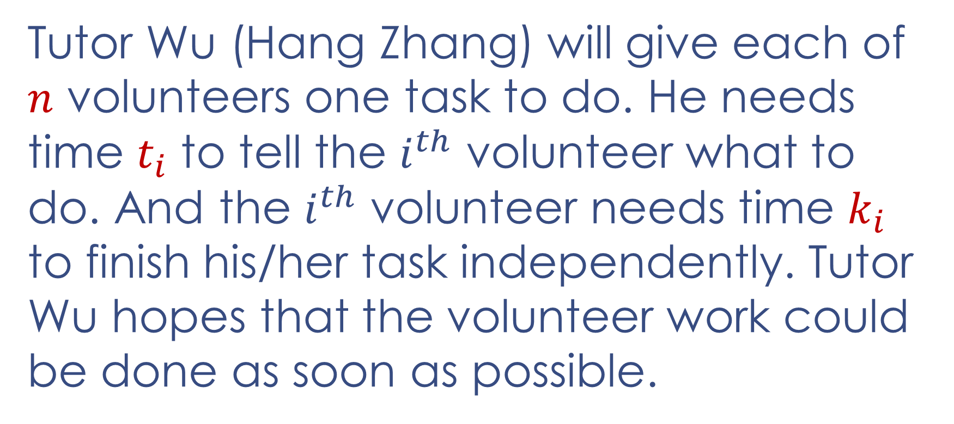
Volunteer
Tutor Wu (Hang Zhang) will give each of $n$ volunteers one task to do. He needs time $t_{i}$ to tell the $i^{th}$ volunteer what to do. And the $i^{th}$ volunteer needs time $k_{i}$ to finish his/her task independently. Tutor Wu hopes that the volunteer work could be done as soon as possible.

Slide 11
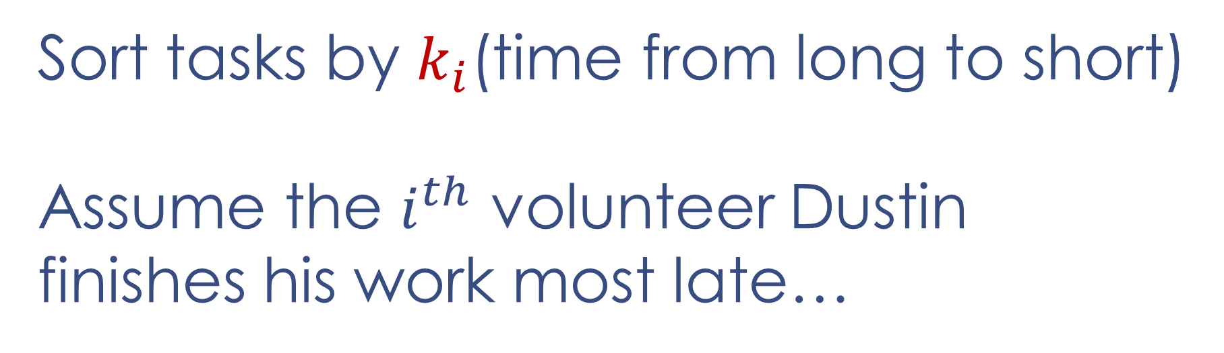
Volunteer
Sort tasks by $k_{i}$(time from long to short)
Assume the $i^{th}$ volunteer Dustin finishes his work most late…

Slide 12
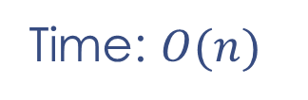
Volunteer
Left pointer moves from the lightest person to right. Right pointer moves from the heaviest person to left. The program ends when two pointers meet.
Time: $O(n)$
1 | 2 | 3 | … | n-1 | n

Slide 13
Arrange Tasks
An Interesting Task for You

Slide 14
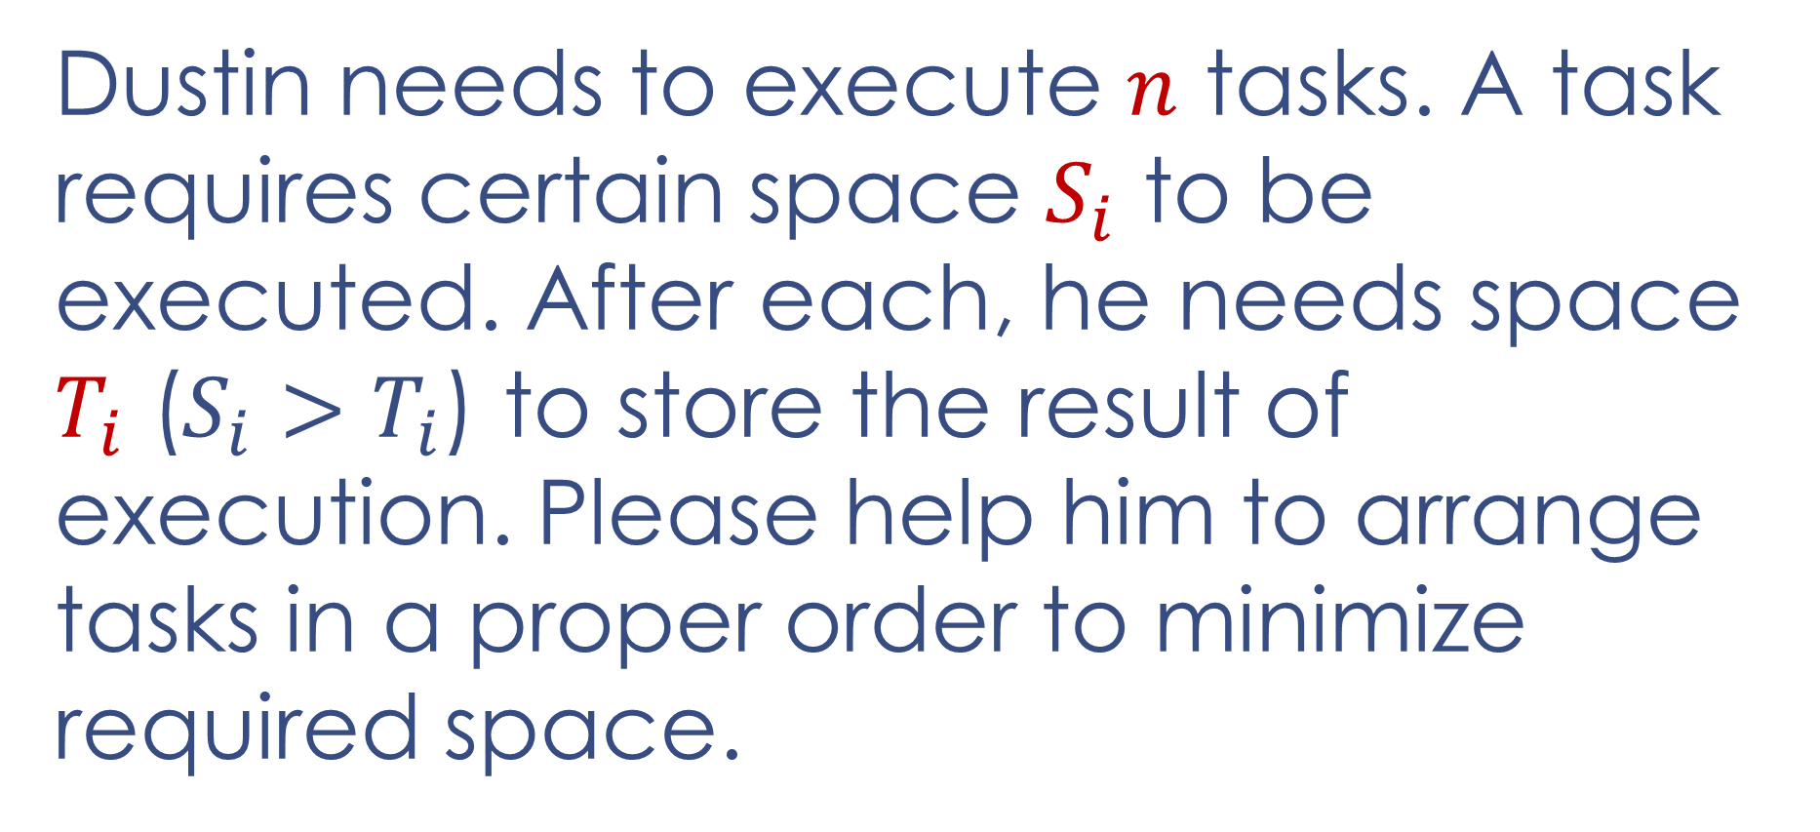
Arrange Tasks
Dustin needs to execute $n$ tasks. A task requires certain space $S_{i}$ to be executed. After each, he needs space $T_{i}$ (${S_{i}>T}_{i}$) to store the result of execution. Please help him to arrange tasks in a proper order to minimize required space.

Slide 15

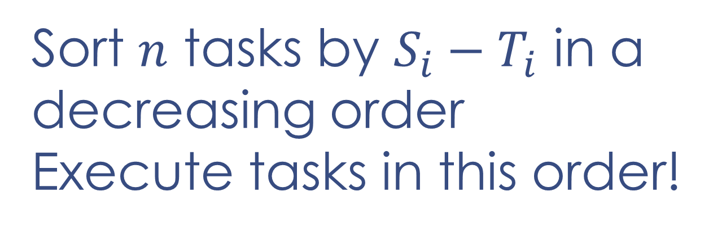
Arrange Tasks
Sort $n$ tasks by ${S_{i}−T}_{i}$ in a decreasing order
Execute tasks in this order!

Slide 16
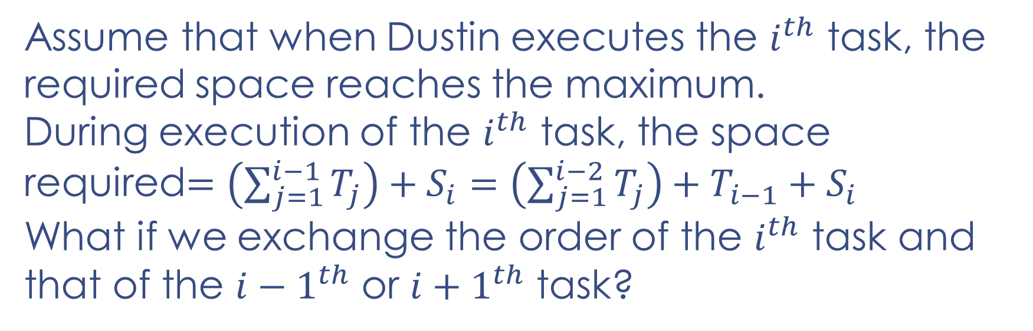
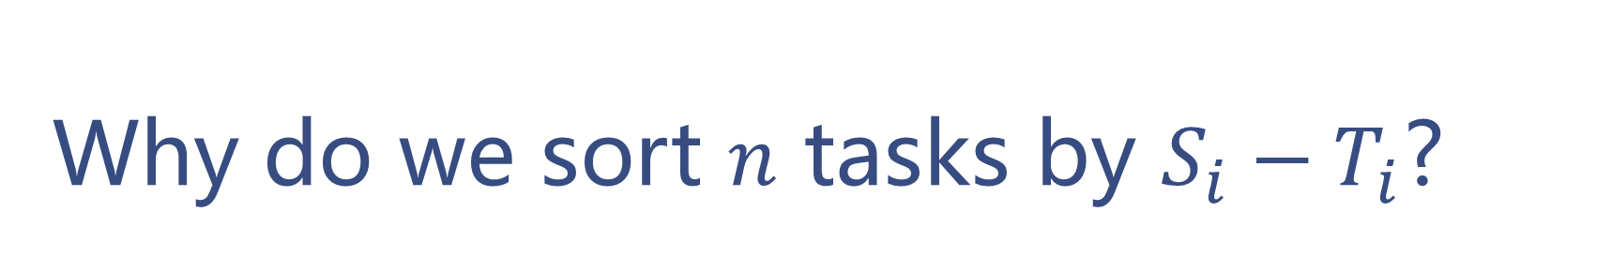
Why do we sort $n$ tasks by ${S_{i}−T}_{i}$?
Assume that when Dustin executes the $i^{th}$ task, the required space reaches the maximum.
During execution of the $i^{th}$ task, the space required$=\left(\sum_{j=1}^{i−1}{T_{j}}\right)+S_{i}=\left(\sum_{j=1}^{i−2}{T_{j}}\right)+T_{i−1}+S_{i}$
What if we exchange the order of the $i^{th}$ task and that of the ${i−1}^{th}$ or ${i+1}^{th}$ task?

Slide 17

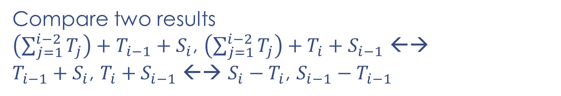
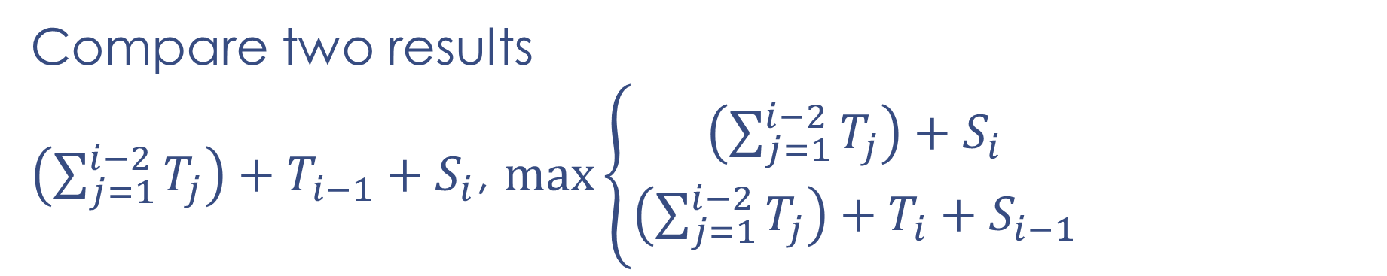
Why do we sort $n$ tasks by ${S_{i}−T}_{i}$?
What if we exchange the order of the $i^{th}$ task and that of the ${i−1}^{th}$ task?
Compare two results
$\left(\sum_{j=1}^{i−2}{T_{j}}\right)+T_{i−1}+S_{i}$, $max\left\{\begin{aligned}\left(\sum_{j=1}^{i−2}{T_{j}}\right)+S_{i} \\ \left(\sum_{j=1}^{i−2}{T_{j}}\right)+T_{i}+S_{i−1}\end{aligned}\right.$
（original maximum）
（revised maximum）
Compare two results
$\left(\sum_{j=1}^{i−2}{T_{j}}\right)+T_{i−1}+S_{i}$, $\left(\sum_{j=1}^{i−2}{T_{j}}\right)+T_{i}+S_{i−1}$ ←→
$T_{i−1}+S_{i}$, $T_{i}+S_{i−1}$ ←→ $S_{i}−T_{i}$, $S_{i−1}−T_{i−1}$

Slide 18
Dustin’s Red Packets
A More Interesting Task for You

Slide 19

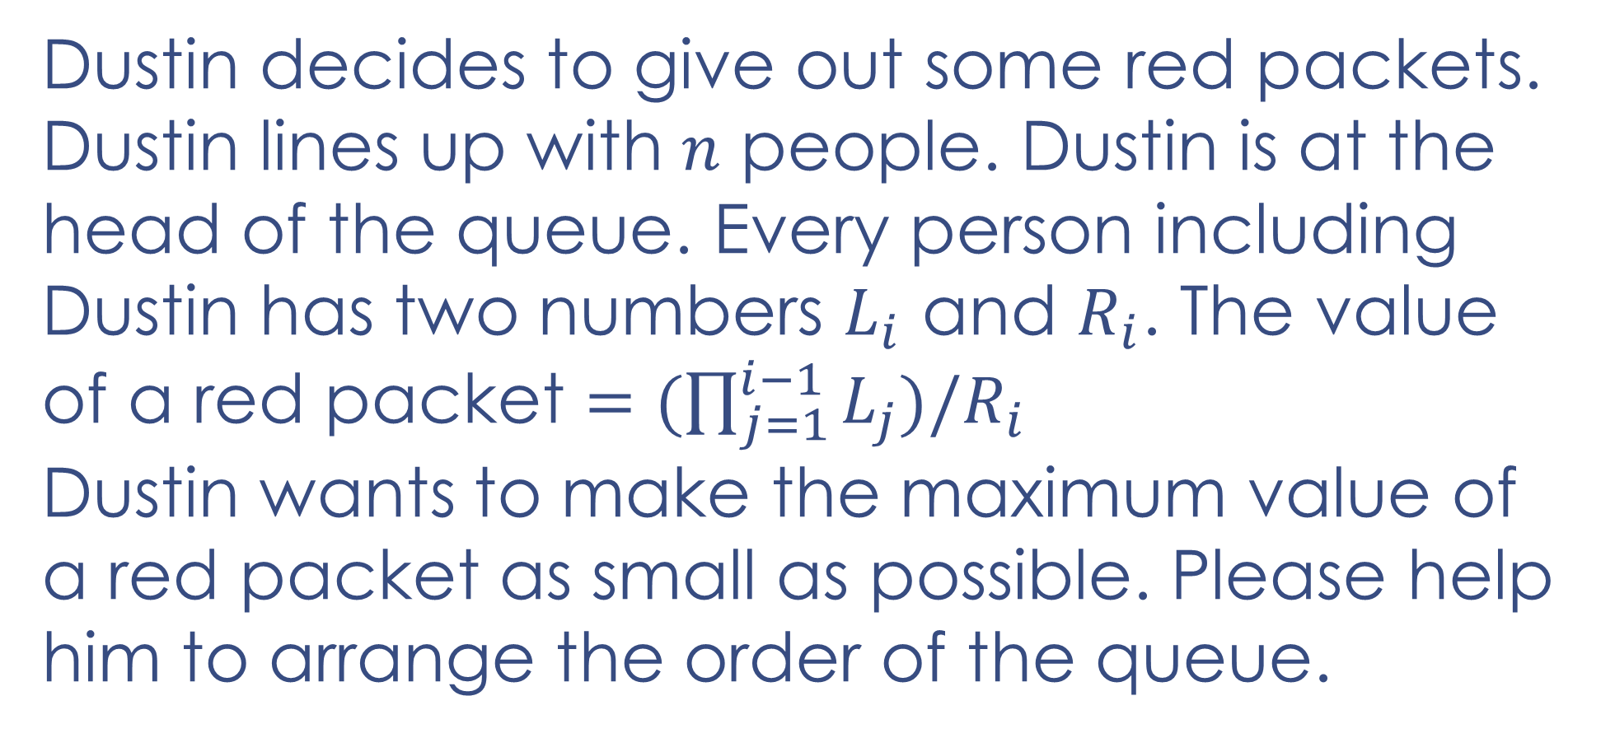
Dustin’s Red Packets
Dustin decides to give out some red packets. Dustin lines up with $n$ people. Dustin is at the head of the queue. Every person including Dustin has two numbers $L_{i}$ and $R_{i}$. The value of a red packet $=(\prod_{j=1}^{i−1}{L_{j}})/R_{i}$
Dustin wants to make the maximum value of a red packet as small as possible. Please help him to arrange the order of the queue.
$$L_{i},R_{i}>1$$

Slide 20
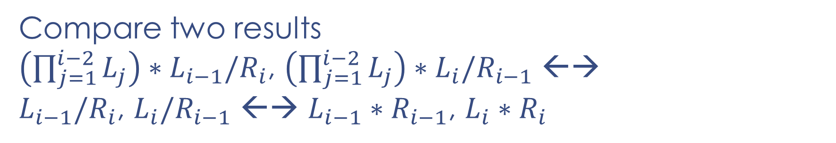
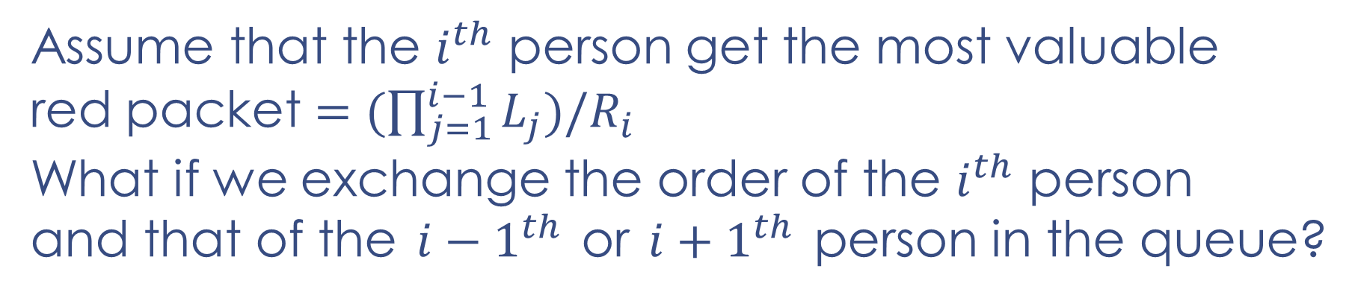

Dustin’s Red Packets
Assume that the $i^{th}$ person get the most valuable red packet $=(\prod_{j=1}^{i−1}{L_{j}})/R_{i}$
What if we exchange the order of the $i^{th}$ person and that of the ${i−1}^{th}$ or ${i+1}^{th}$ person in the queue?
Compare two results
$\left(\prod_{j=1}^{i−2}{L_{j}}\right)∗L_{i−1}/R_{i}$, $\left(\prod_{j=1}^{i−2}{L_{j}}\right)∗L_{i}/R_{i−1}$ ←→
$L_{i−1}/R_{i}$, $L_{i}/R_{i−1}$ ←→ $L_{i−1}∗R_{i−1}$, $L_{i}∗R_{i}$
Greedy Strategy: Sort by $L_{i}∗R_{i}$!

Slide 21
Dustin’s Red Packets
So Red Packet Time!

Slide 22
Thank you!

